Slide 1
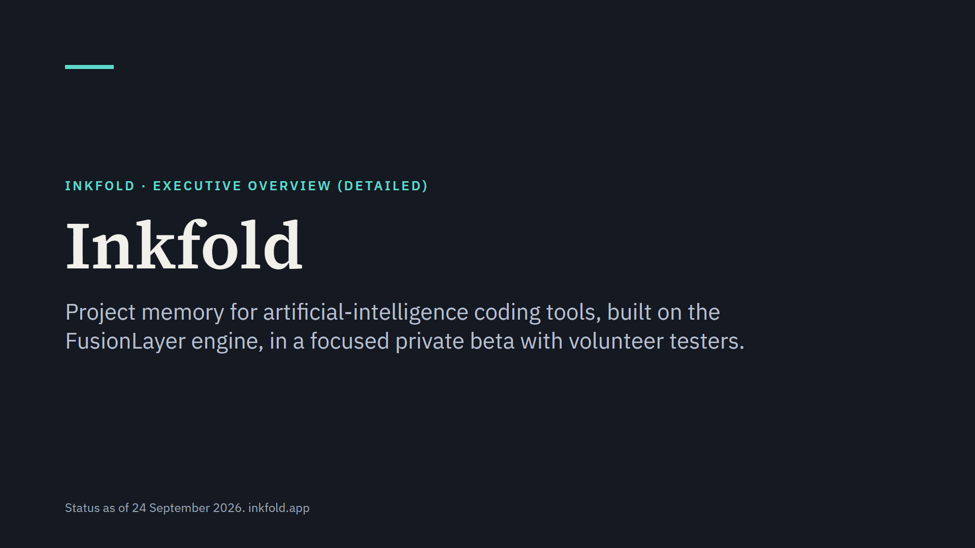
Notes:
Inkfold keeps one memory per project of the decisions a person settles while working with artificial-intelligence tools, and hands it to the next tool. Nothing is charged yet and there are no paying customers. This presentation covers the problem, the product, pricing, the alternatives, the evidence so far and what comes next.

Slide 2
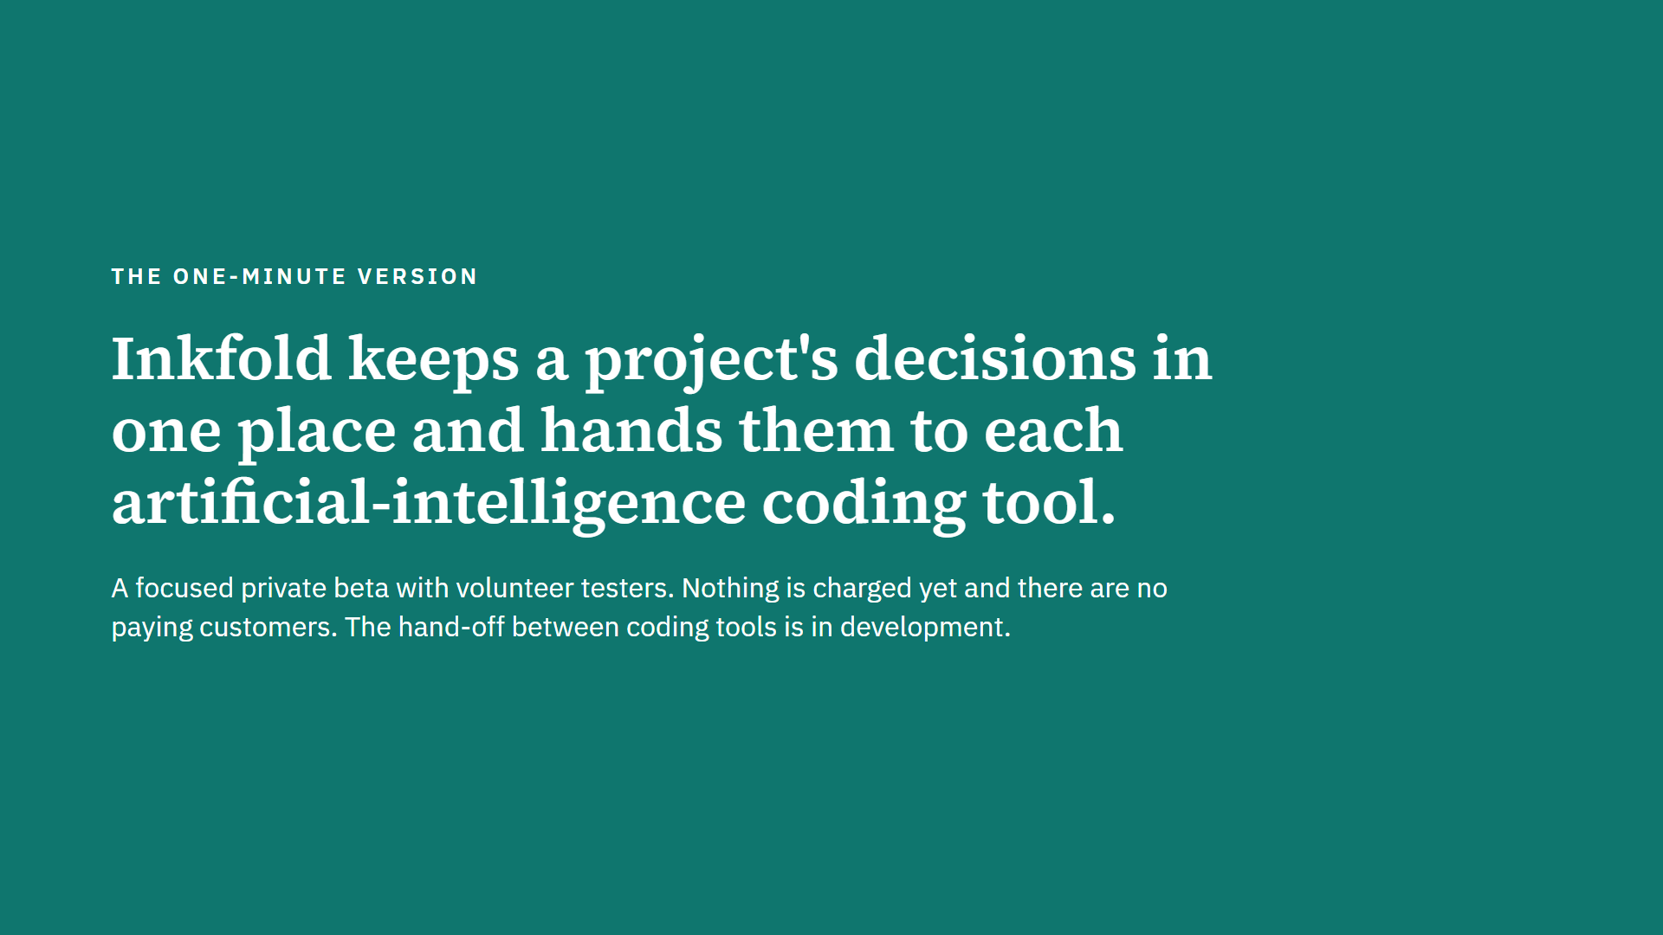
Notes:
A person settles a decision in one coding tool; Inkfold keeps it with its source and offers it to the next tool. The person chooses per conversation what Inkfold stores. Carrying a decision from one tool to another is in development and has not yet been verified on a clean machine.

Slide 3
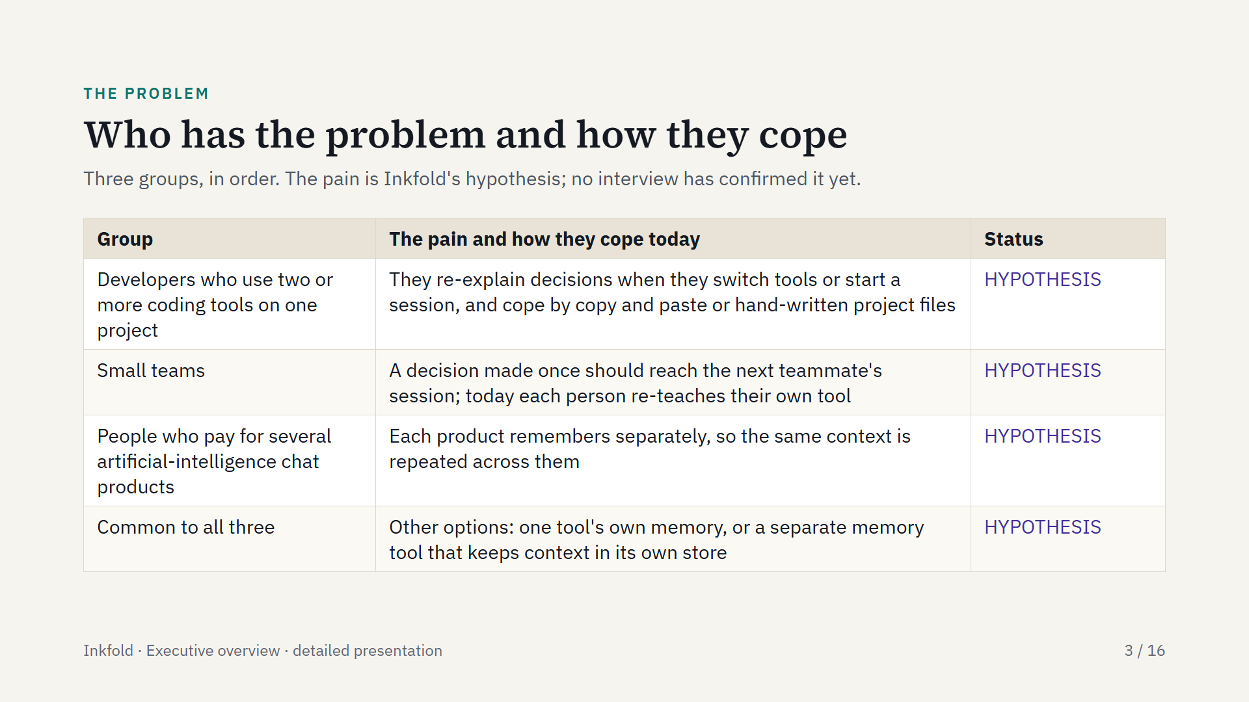
Notes:
The pain is the same in each group: context has to be re-explained to each artificial-intelligence tool. Developers come first because their pain is sharpest and they can install a local program and use their own model keys. Larger organizations can contact Inkfold; features for organizations are planned and not offered yet.

Slide 4
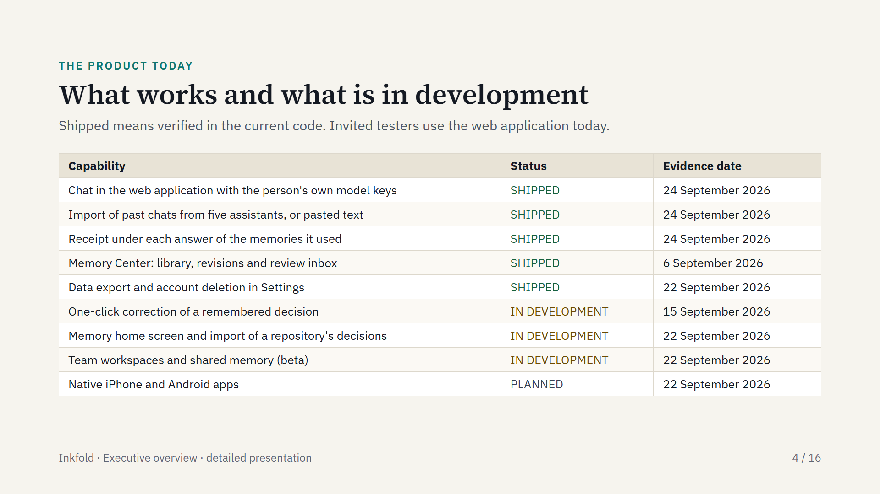
Notes:
The first five rows work today for invited testers. One-click correction and the memory home screen are built; their release to testers is still to be confirmed. Team workspaces are labelled beta. On phones the web application is responsive; native apps come later.

Slide 5
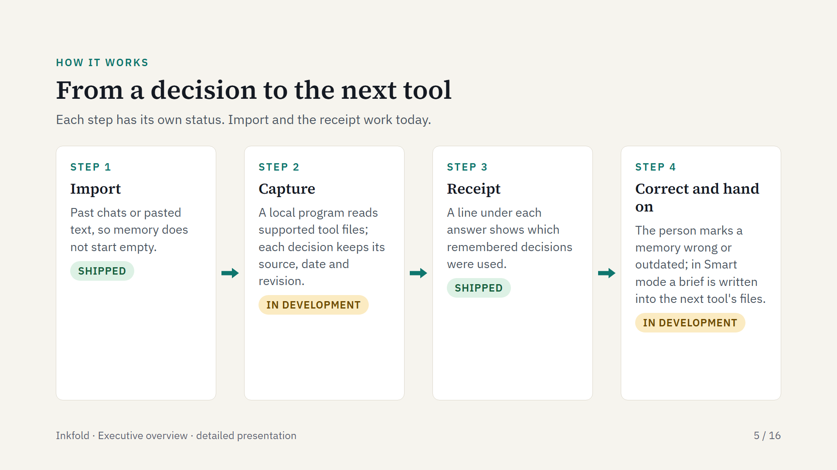
Notes:
Import and the memory receipt exist in the web application today. Capture from tool sessions, correction and the hand-off are in development. In Private and Incognito modes the local program writes no content into project files; it leaves a content-free notice instead. Tools can also recall memory over the Model Context Protocol, an open standard that lets artificial-intelligence tools call outside tools and memory.

Slide 6
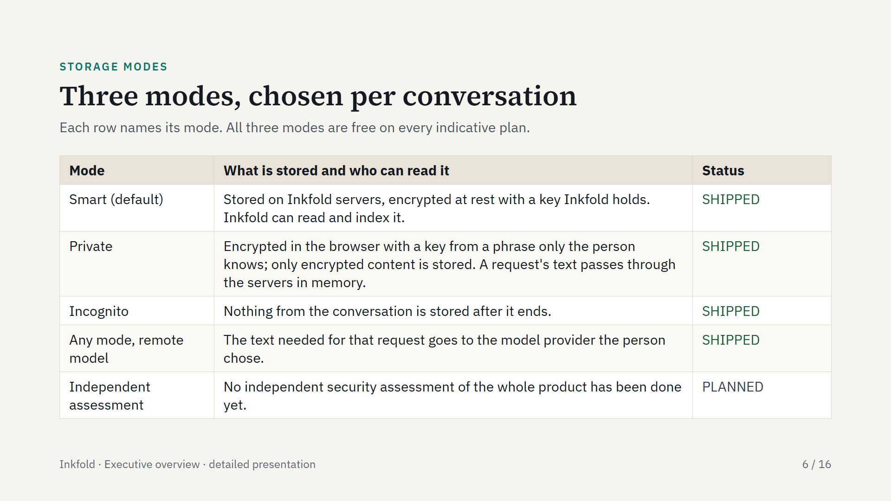
Notes:
Smart is the default because it gives the best memory quality. Private mode gives up server-side indexing, and Inkfold cannot restore access if the phrase is lost. Incognito keeps nothing. No certification is claimed.

Slide 7
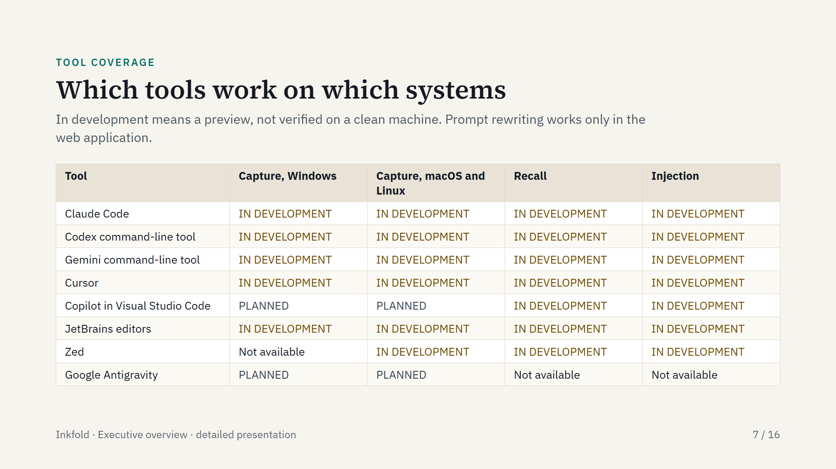
Notes:
Capture means recording prompts and answers from a tool; recall means searching memory from inside a tool; injection means adding remembered context before a new prompt. On macOS and Linux there is no installer yet, so a developer installs from source. Capture on iPhone and Android is planned. About thirty further tools sit at the same preview level. Google Antigravity is blocked because its session files are encrypted. The benefit of prompt rewriting is not measured.

Slide 8
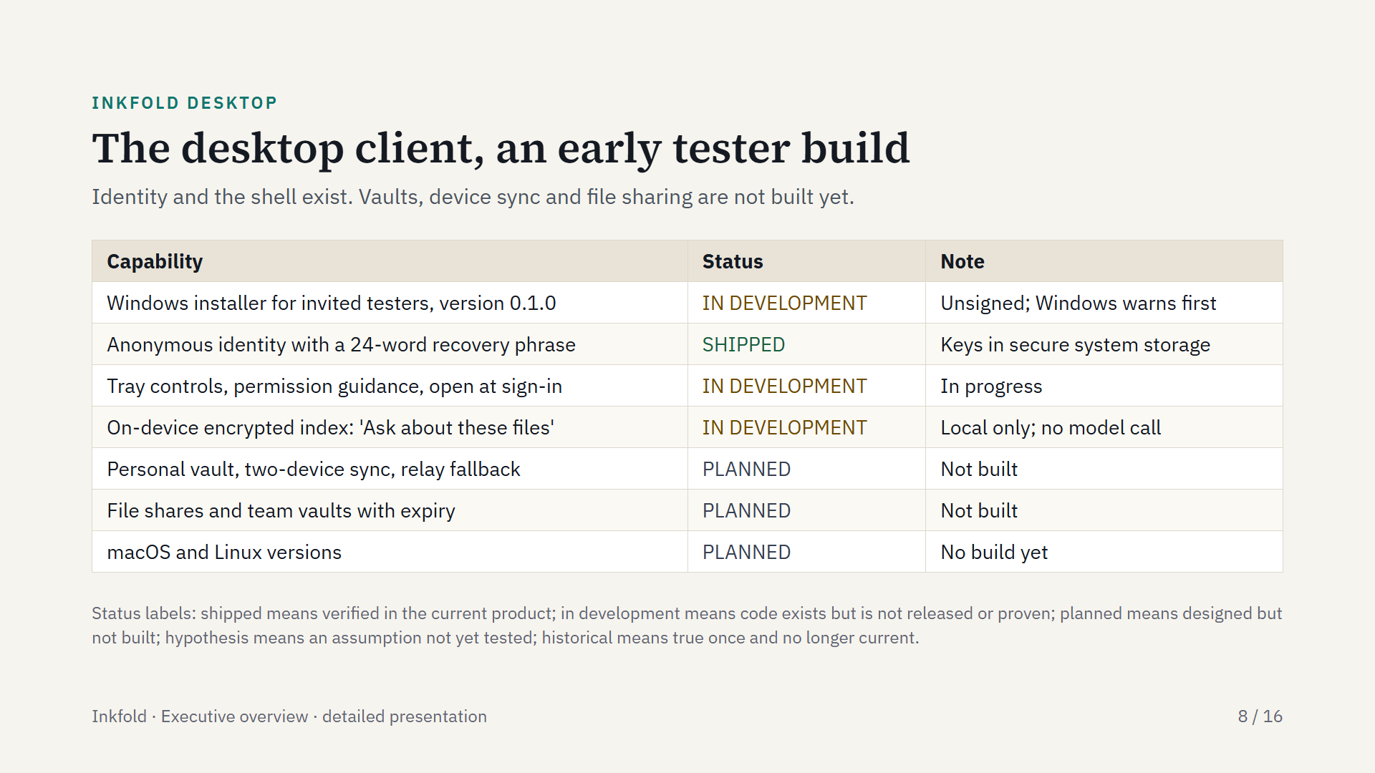
Notes:
Inkfold Desktop brings the web application and the local runtime together on a Windows computer. It is an early tester build for invited testers. Vaults, device sync and file shares are designed but not built. The interface inside Desktop is a copy of the web application from 9 August 2026.

Slide 9
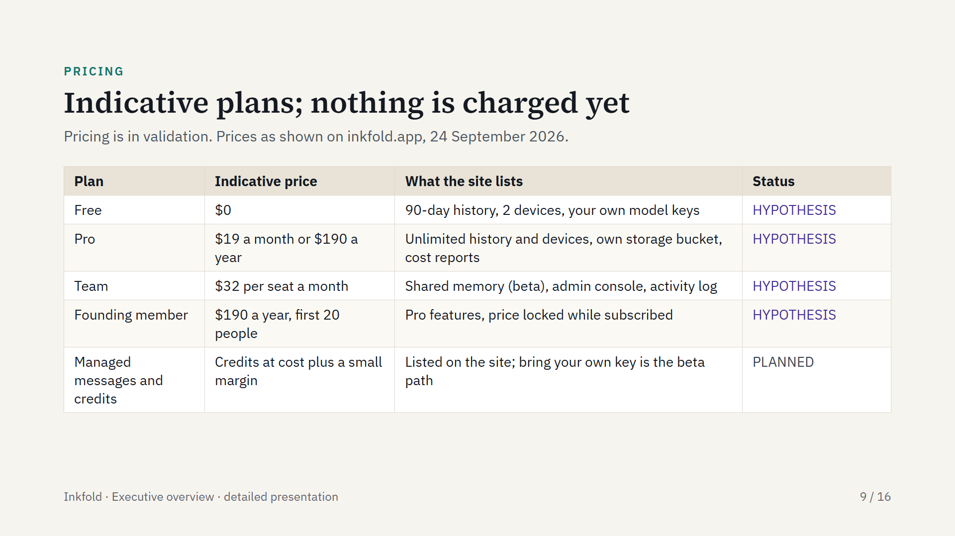
Notes:
These are the indicative prices the site shows today. Checkout is not open, so no one can pay yet; checkout opens with the founding cohort. With bring your own key, the model provider bills model use directly. Larger organizations can contact Inkfold.

Slide 10
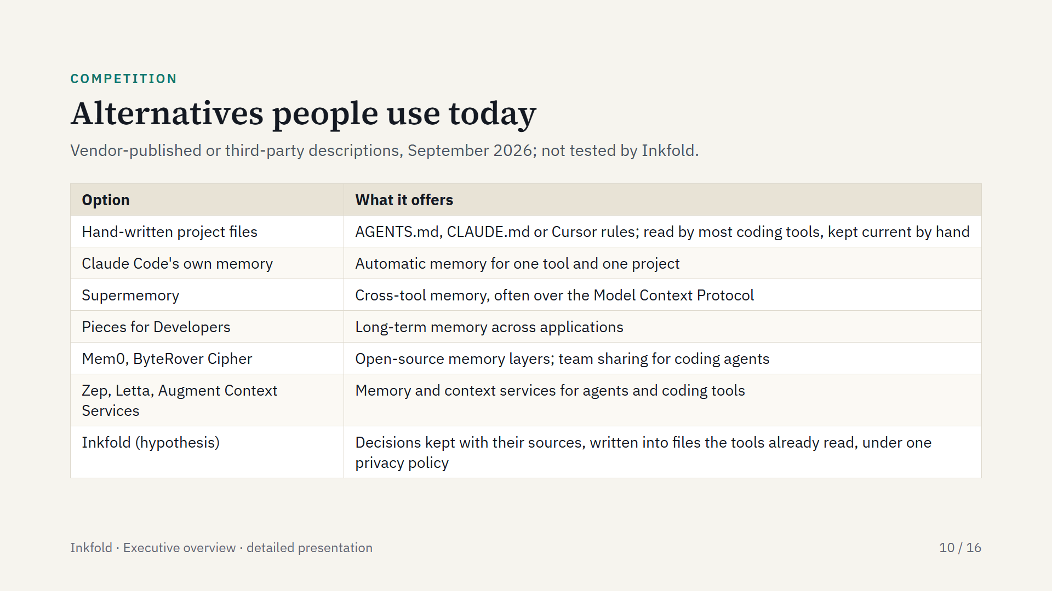
Notes:
Several vendors and independents offer memory or portability today, so Inkfold does not claim that others cannot build this. Chat workspaces across many models, such as TypingMind and LibreChat, overlap with Inkfold's chat side, which is not the lead. Its differentiation hypothesis is the specific behaviour once shipped and measured: capture across tools, recall scoped to a project and injection into each tool, under one privacy policy. No side-by-side comparison has been published yet.

Slide 11
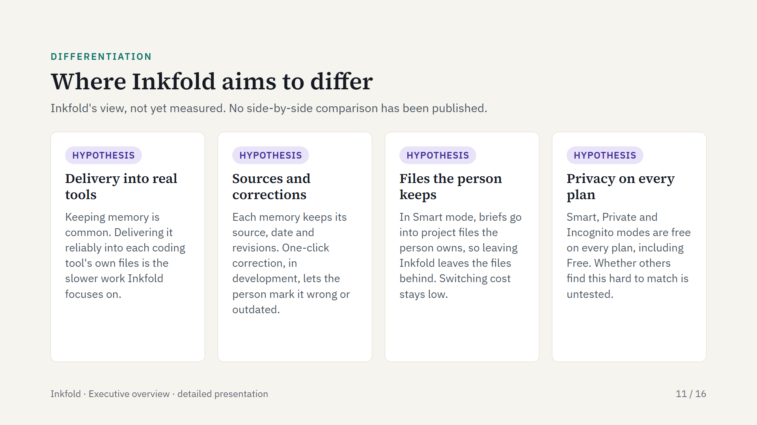
Notes:
These are hypotheses. Adding memory is easy for anyone; the candidate advantage is reliable delivery into real tools combined with a correction loop the person controls, and it has to be shown in use.

Slide 12
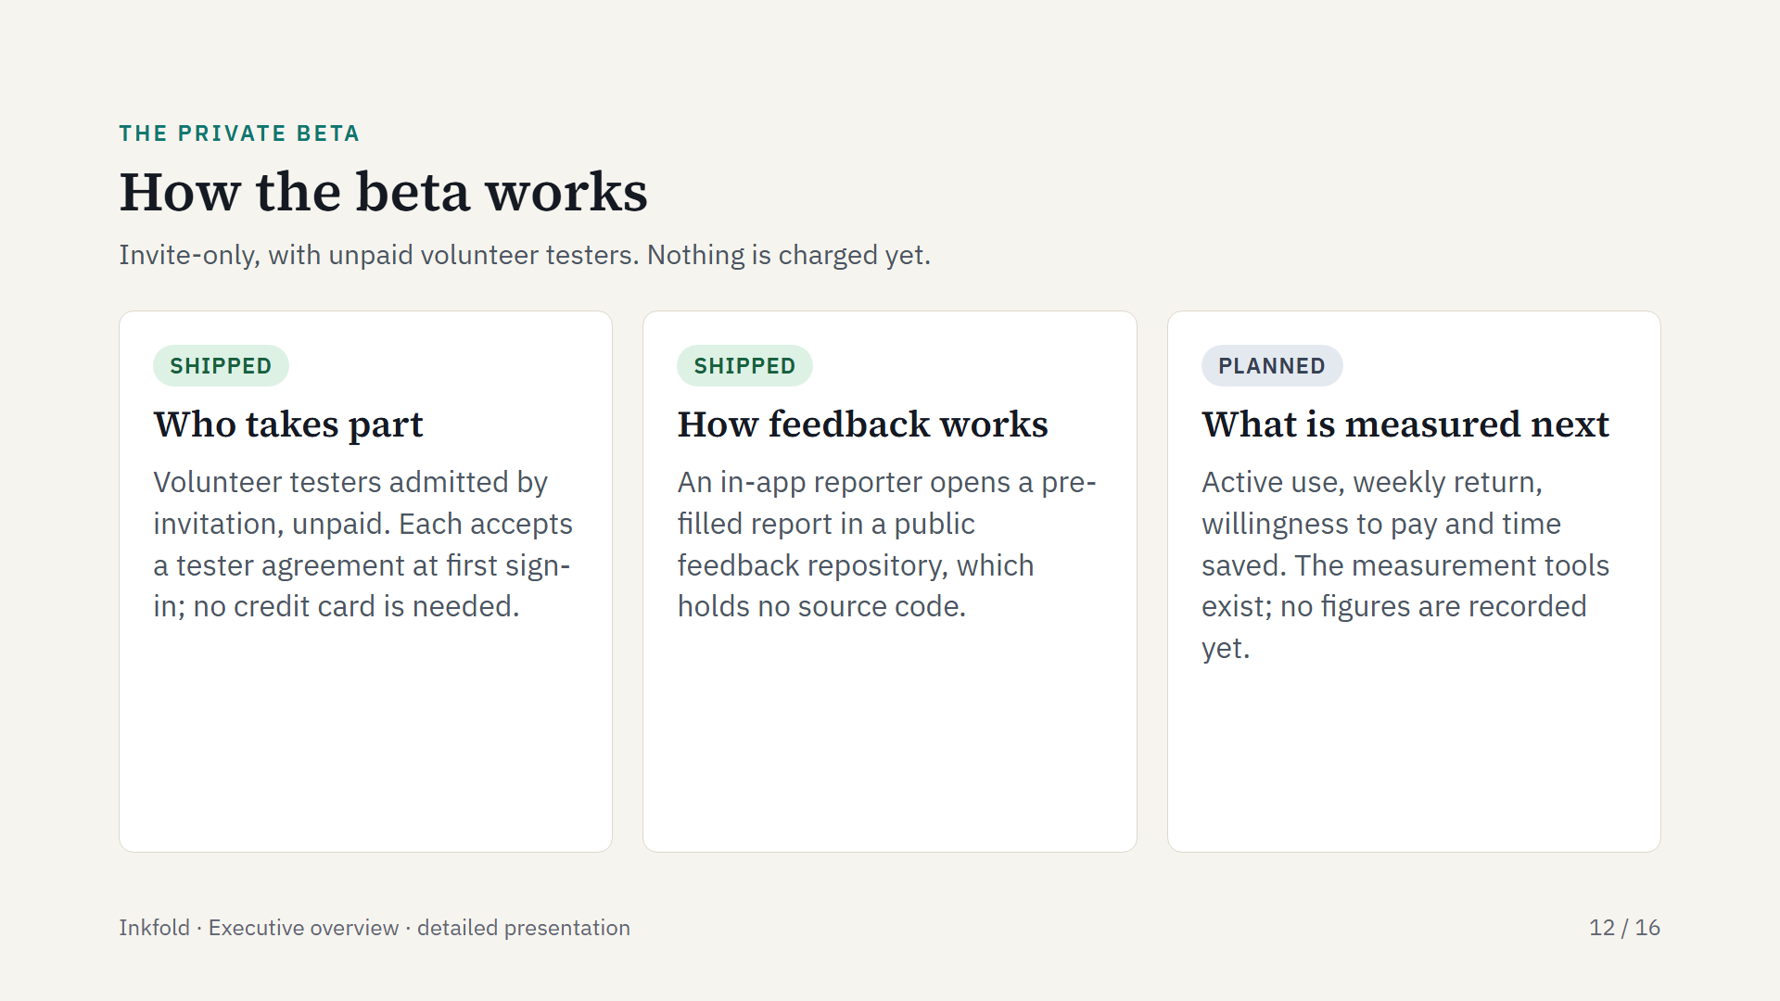
Notes:
The beta was planned in June 2026 for 15 to 30 serious users rather than a mass sign-up. Testers filed 12 reports between 18 August and 5 September 2026: 6 bugs, 5 on user experience and 1 feature request. All 12 are closed.

Slide 13
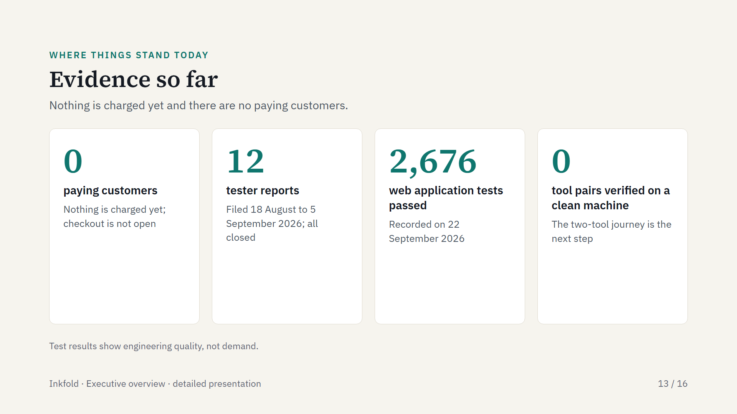
Notes:
Checkout is not open, so no one can pay yet. The tester reports are public in the feedback repository. The journey that carries a decision from one coding tool to another has not yet been run on a clean machine.

Slide 14
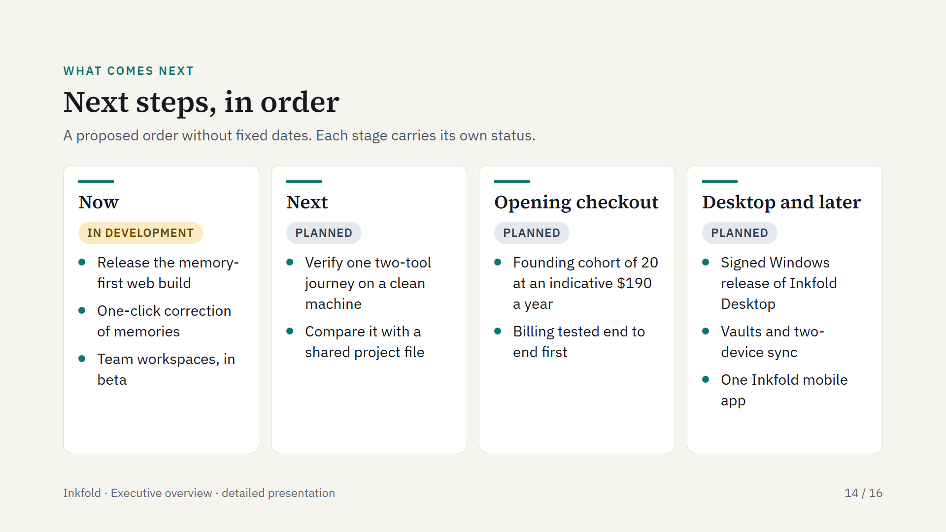
Notes:
The order is a proposal, not a set of dates. The two-tool journey means: install, pick a project and a mode, record a decision in one coding tool, see it applied with its source in another, correct it, confirm that a second project does not receive it, and export.

Slide 15
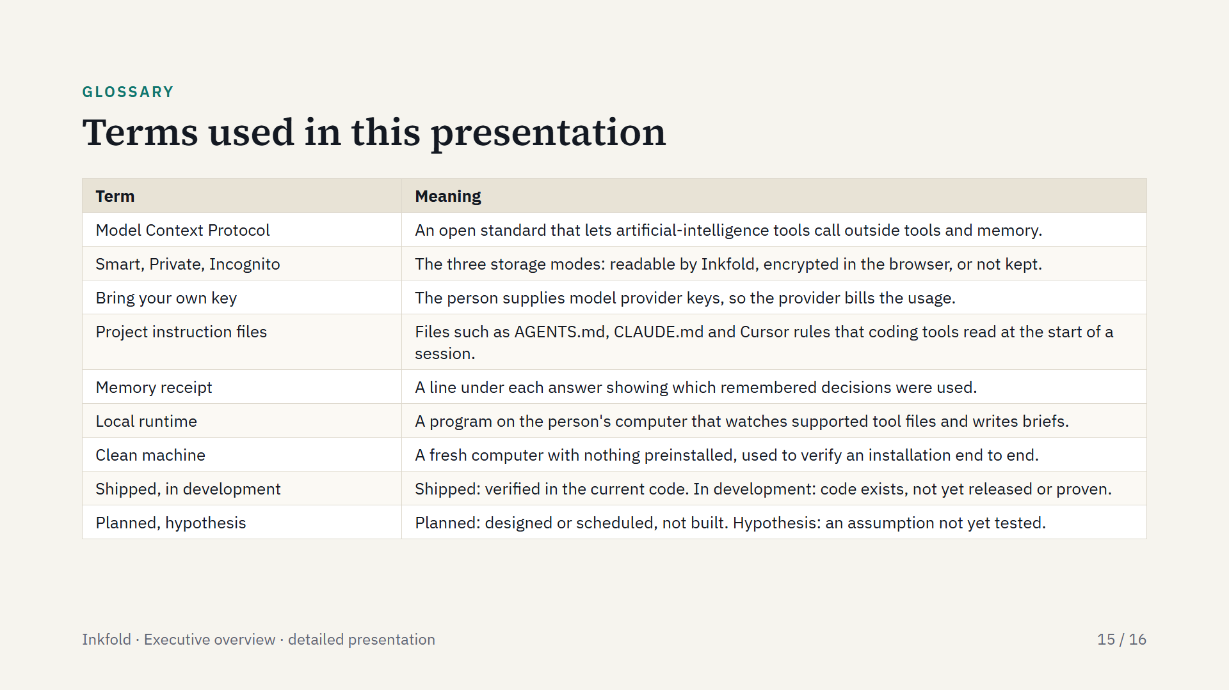
Notes:
Definitions for terms a reader may not know. The four status words are used on every capability in this presentation.

Slide 16
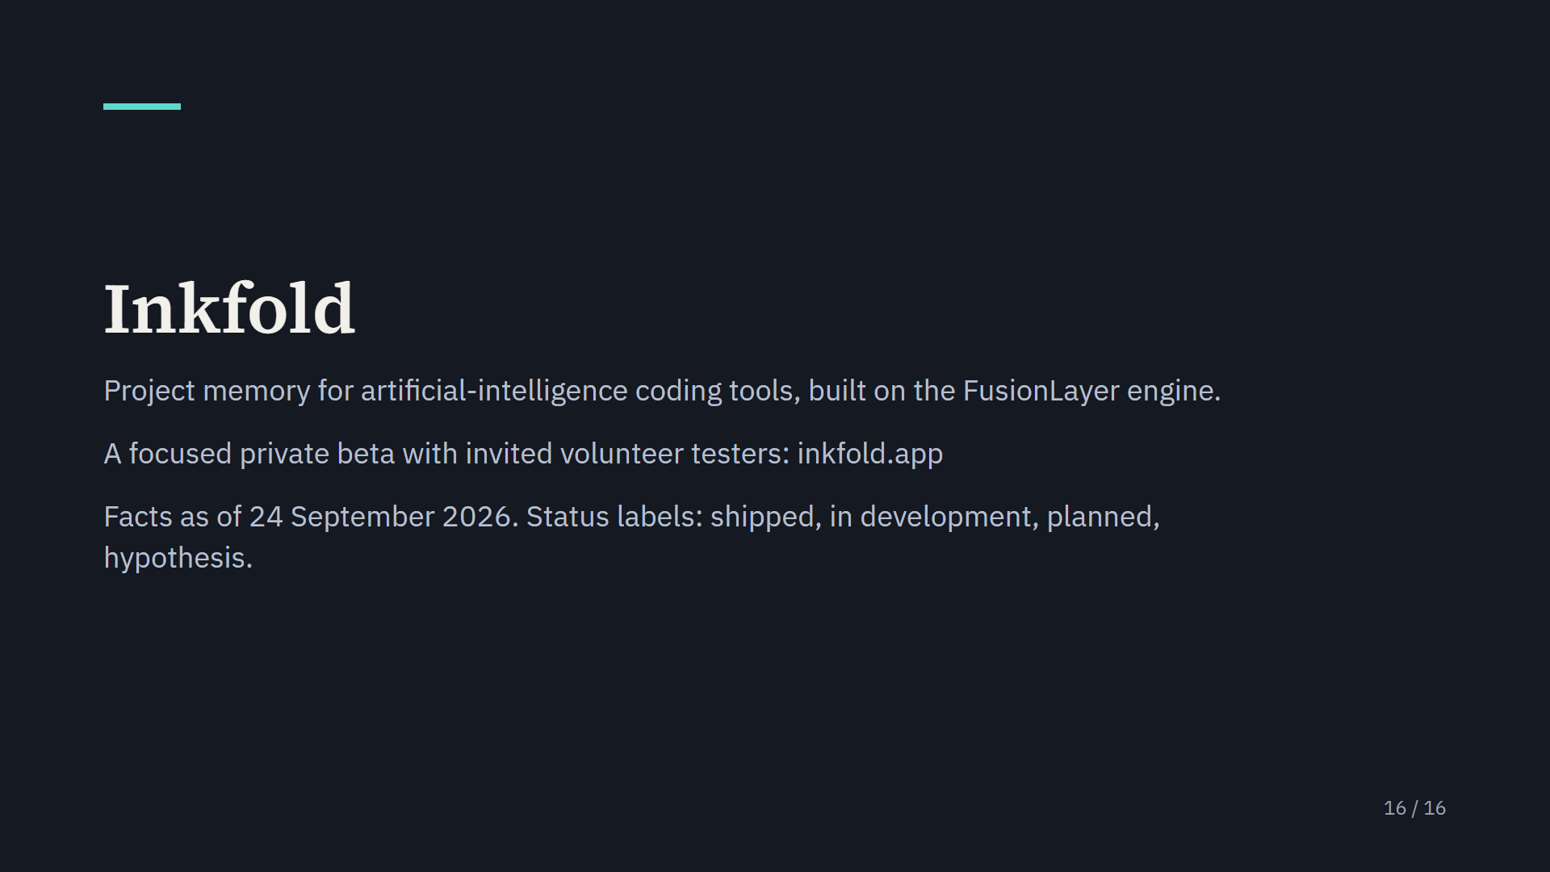
Notes:
Inkfold is in a focused private beta and nothing is charged yet. More at inkfold.app.

