Slide 1
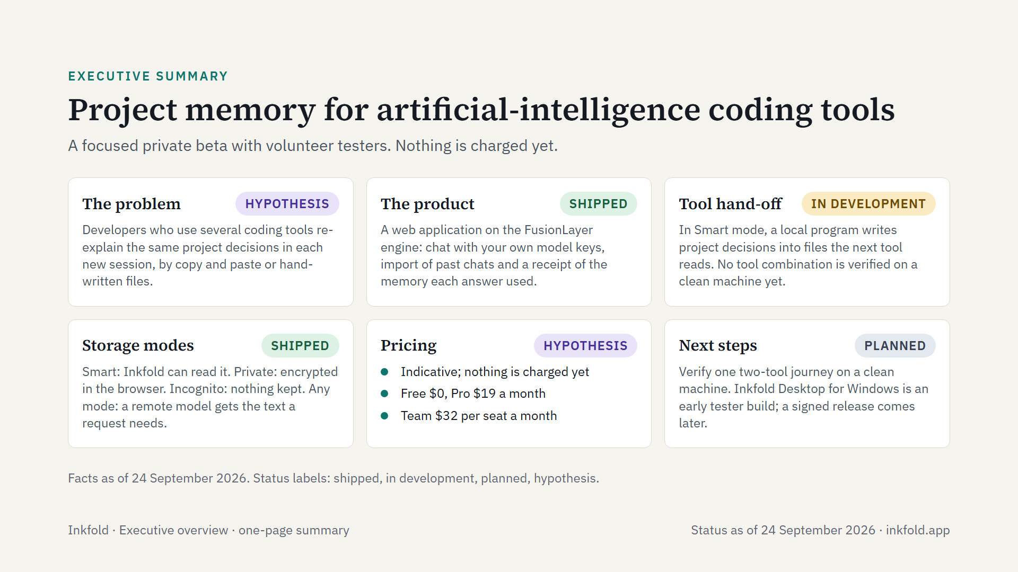
Notes:
Inkfold on one page, as of 24 September 2026. Inkfold keeps one memory per project of the decisions a person settles with artificial-intelligence tools, and hands it to the next tool. It is a focused private beta with volunteer testers: nothing is charged yet and there are no paying customers.

