Slide 1
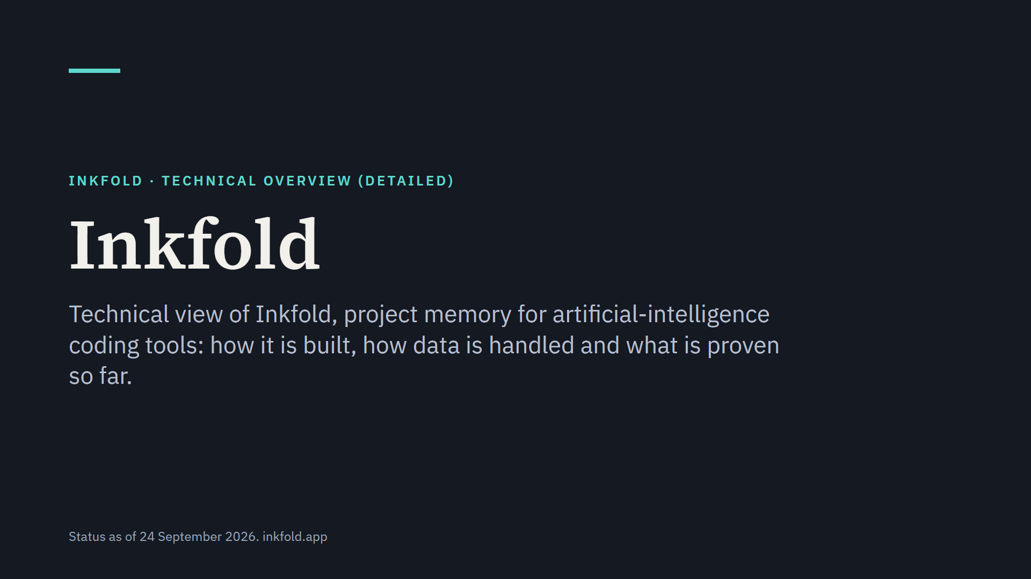
Notes:
This presentation covers the architecture, the data model and interfaces, capture and the desktop client, the security and privacy design, testing and the release gates. Plain words come first and precise terms second. Inkfold is in a focused private beta; nothing is charged yet.

Slide 2
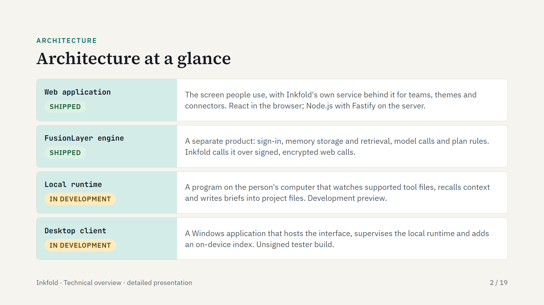
Notes:
The web application and Inkfold's own service are what invited testers use today. The FusionLayer engine is a separate product for developers, and Inkfold is its first customer; the boundary between them is a signed, encrypted web interface only. The local runtime and the Windows desktop client carry context to coding tools on the person's computer; both are in development.

Slide 3
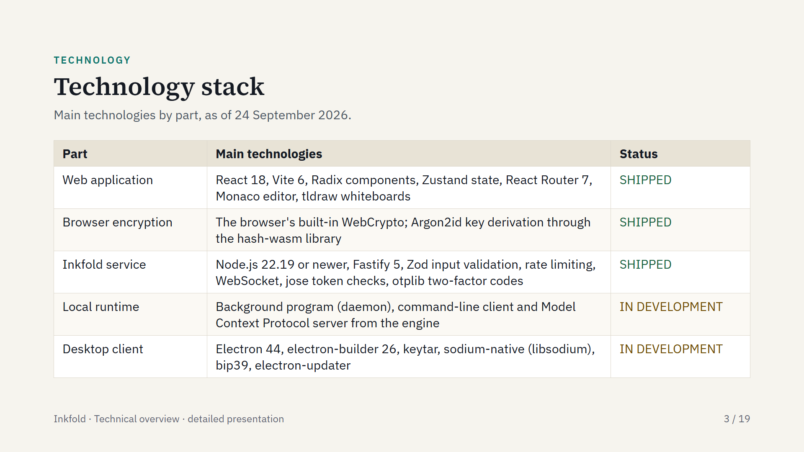
Notes:
The web application is a single-page application that can also be installed on a phone as a progressive web application, which behaves like an installed app. The FusionLayer engine, a separate product, provides sign-in, memory storage and retrieval, model calls and plan rules. On the desktop, keytar keeps keys in the operating system's secure storage. The desktop client bundles the local runtime and a Node.js runtime in a per-user Windows installer that needs no administrator rights.

Slide 4
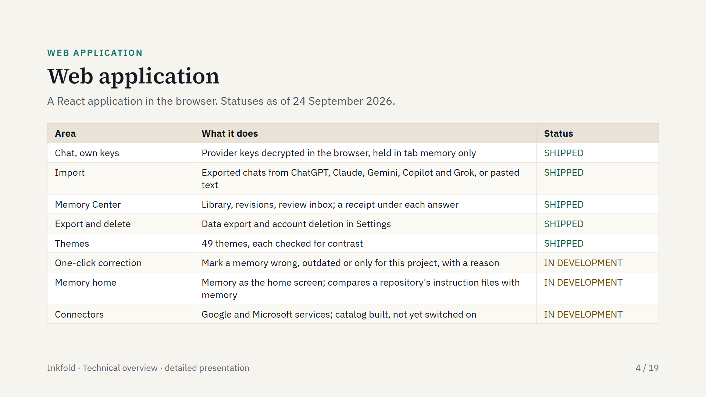
Notes:
Provider keys are stored as encrypted text and decrypted in the browser after the person unlocks them; the decrypted key stays in the tab's memory only. One-click correction and the memory home screen are built; their release to testers is still to be confirmed. On phones the web application is responsive. Prompt rewriting in the composer is shipped; its benefit is not measured.

Slide 5
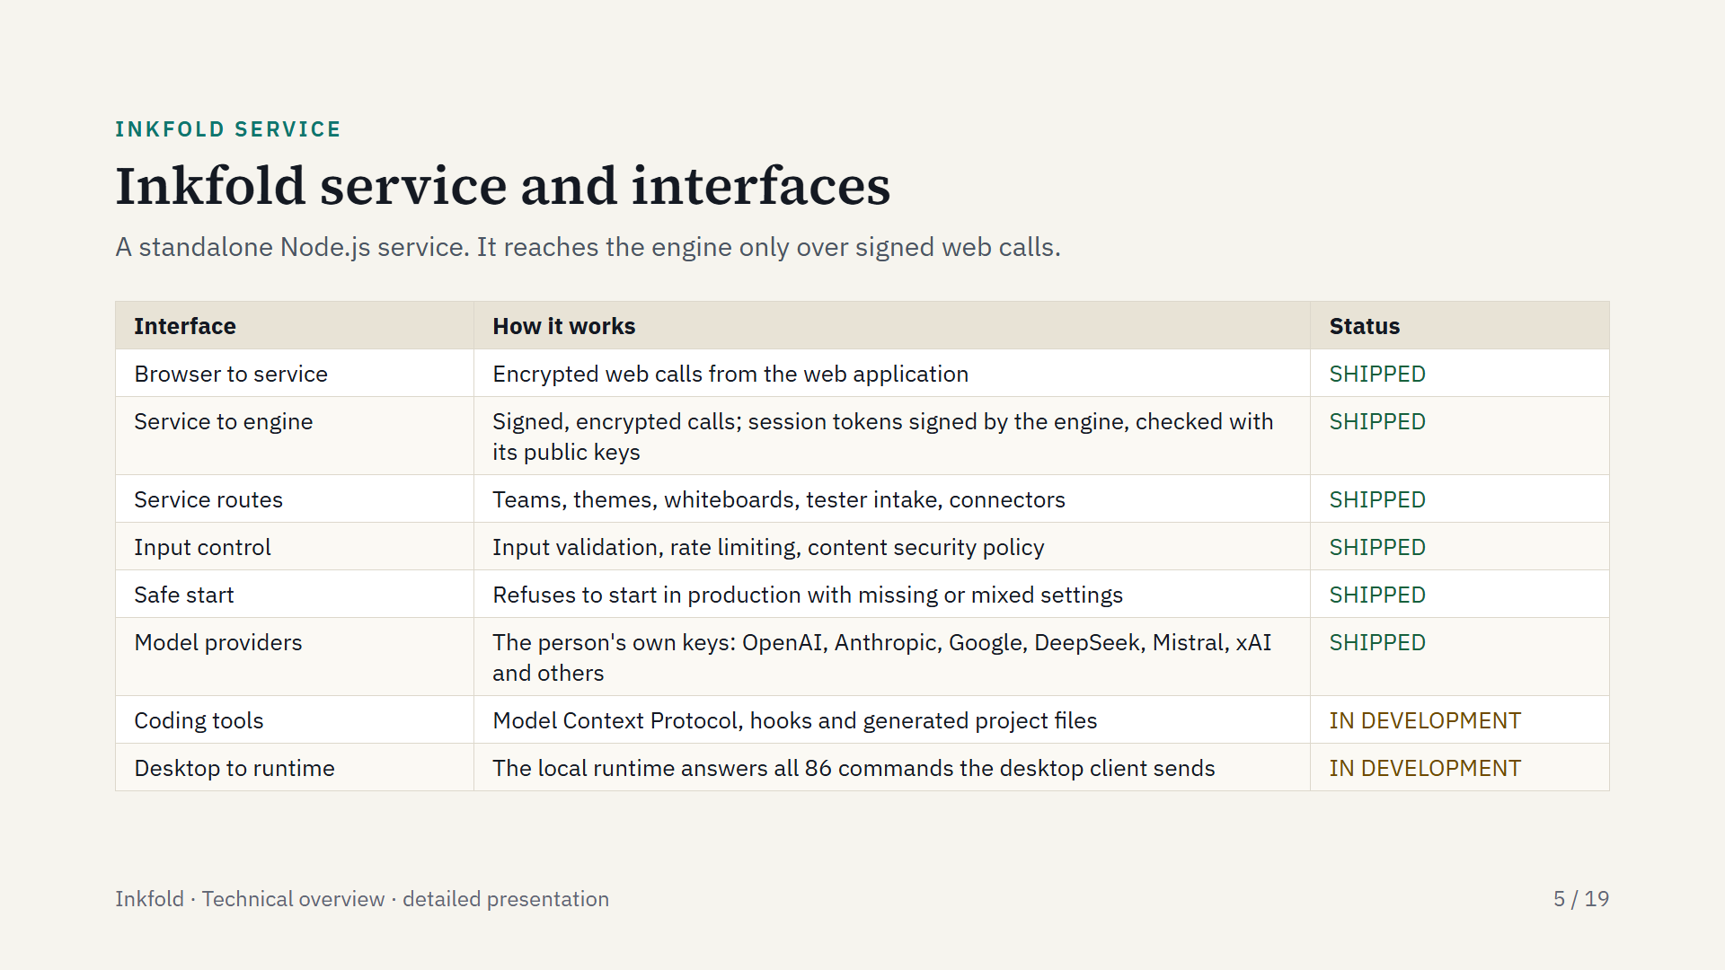
Notes:
Inkfold's own service owns only Inkfold-specific routes; the engine owns sign-in, memory, model calls and plan rules. Session tokens are signed by the engine with an asymmetric key. A hook is a small script a coding tool runs at set moments, such as before a prompt. On 22 September 2026 the local runtime answered all 86 commands the desktop client sends; a packaged desktop build with this runtime is still to be verified.

Slide 6
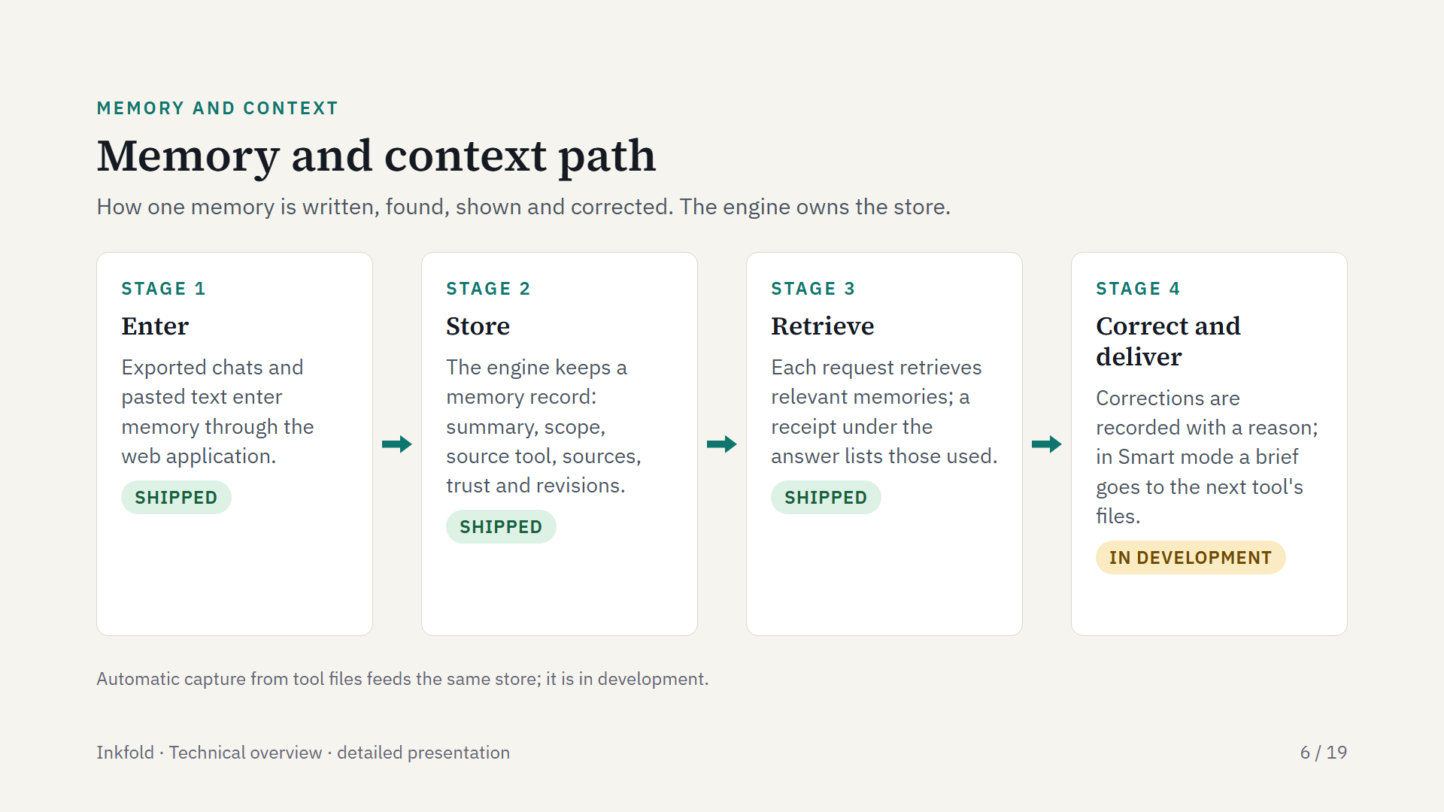
Notes:
Memory enters today through import and chat. Each memory is a record with a summary, scope, source tool, sources, trust, confidence, use count and revisions. Correction is built; its release to testers is still to be confirmed. In Private and Incognito modes no brief with content is written into project files.

Slide 7
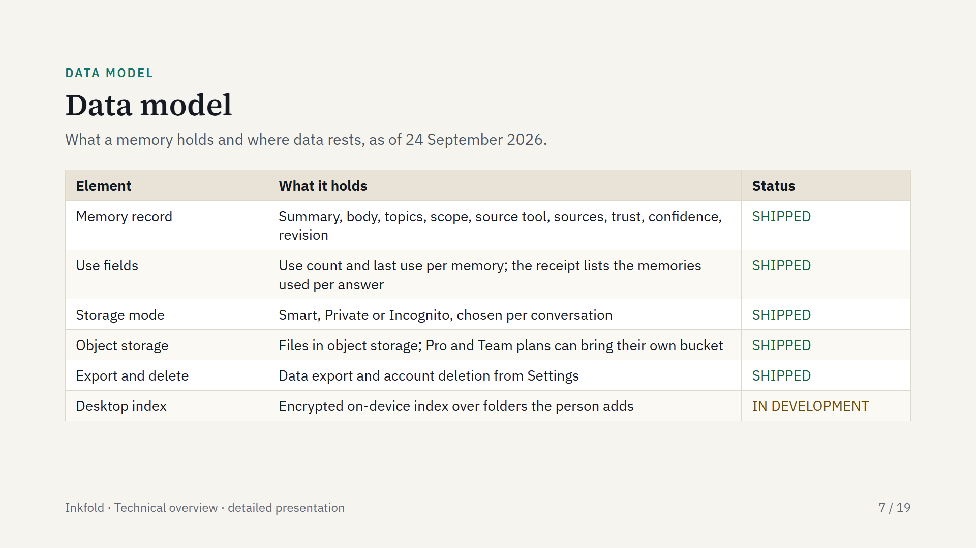
Notes:
The record fields are those a memory card shows, including pinned, expiry and whether the person may change the record. Inkfold's sub-processors are listed on the public privacy page.

Slide 8
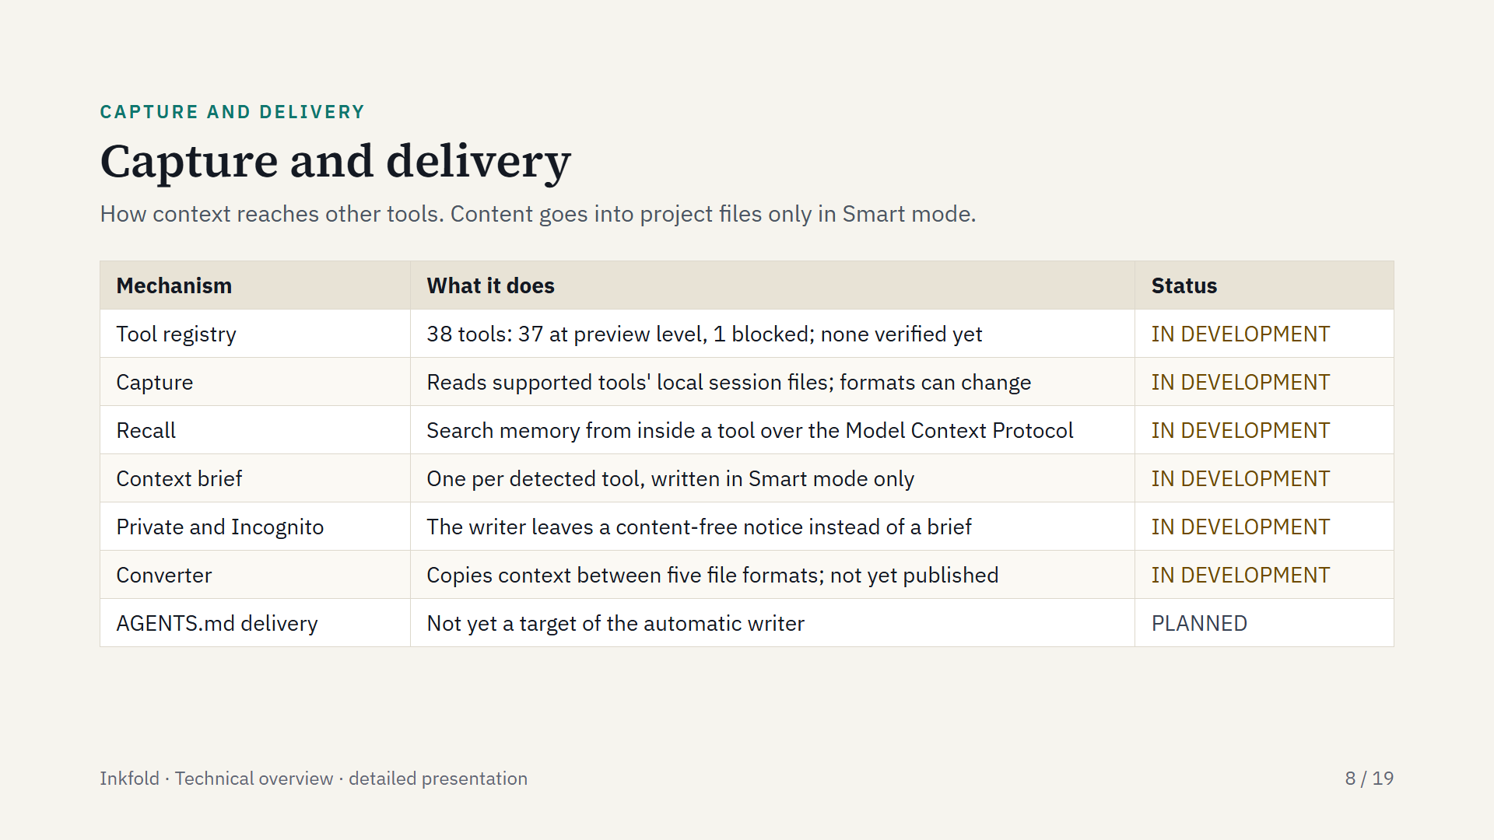
Notes:
Google Antigravity is blocked because its session files are encrypted and it offers no export or hook; nothing is decrypted. The brief is written to CLAUDE.md for Claude Code, or to a separate file if the person owns CLAUDE.md, to a rules file in the Cursor project folder, and to tool-specific files for other tools. The converter moves context between Claude Code memory, CLAUDE.md, AGENTS.md, Cursor rules and Copilot instructions.

Slide 9
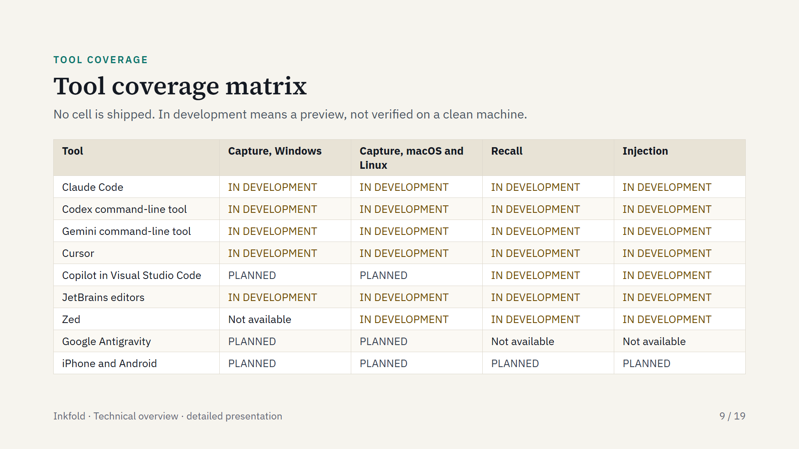
Notes:
Capture means recording prompts and answers from a tool; recall means searching memory from inside a tool; injection means adding remembered context before a new prompt. On macOS and Linux there is no installer, so a developer installs from source. The JetBrains plugin targets the 2024.3 editors. About thirty further tools sit in the registry at the same preview level. Prompt rewriting is shipped inside the web application only, and its benefit is not measured.

Slide 10
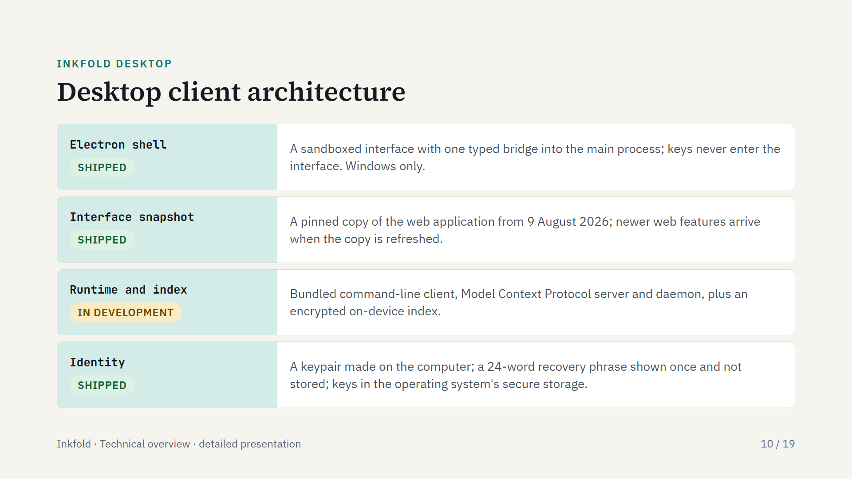
Notes:
Inkfold Desktop is an Electron application for Windows, offered as an early tester build. The installer bundles the command-line client, the Model Context Protocol server, the daemon and the Node.js runtime, installs per user and needs no administrator rights. The shell supervises the runtime. The on-device index matches words today rather than meaning.

Slide 11
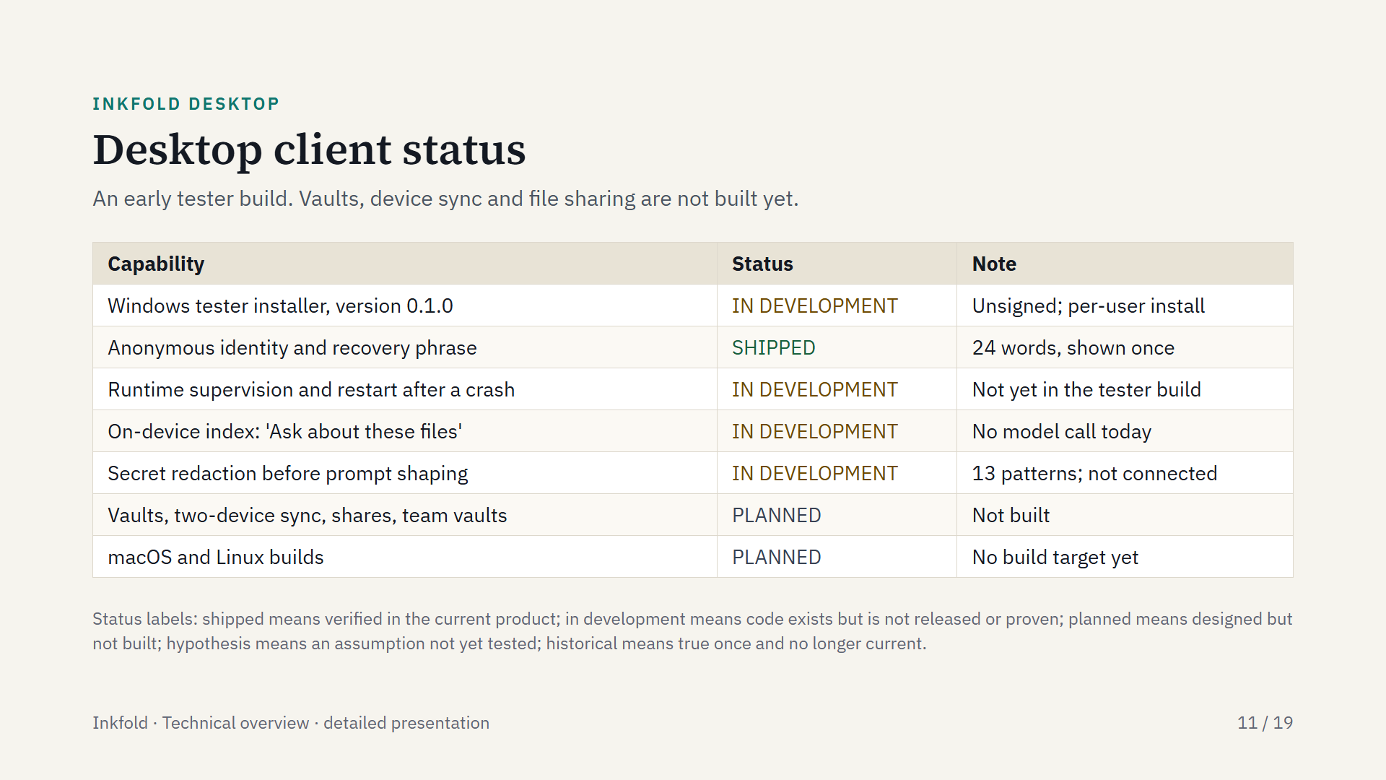
Notes:
Local-only mode on the desktop means the on-device index: answers come from the index and no model call is made today. The redaction step removes 13 kinds of secrets before a prompt is shaped; sending a shaped prompt to a model provider is not connected yet.

Slide 12
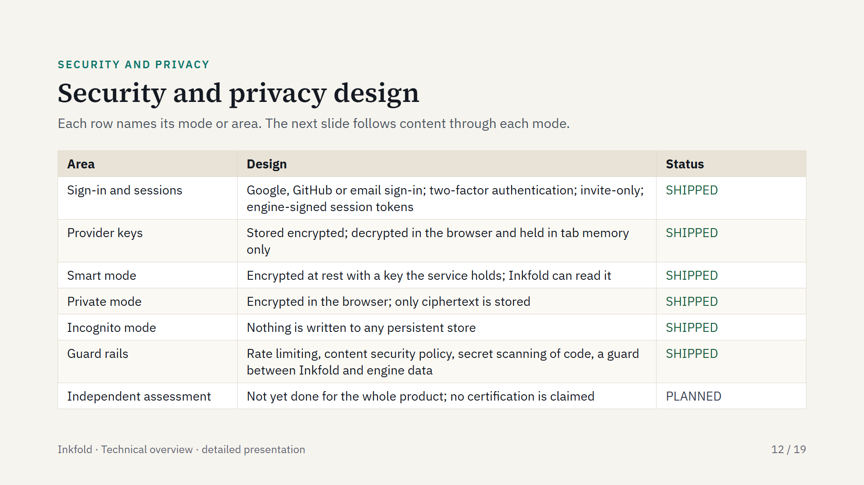
Notes:
Registration is by invitation, and two-factor authentication is available at sign-in. Sessions are signed by the engine with an asymmetric key. Any assessment cited later would cover only a named library and a named mode.

Slide 13
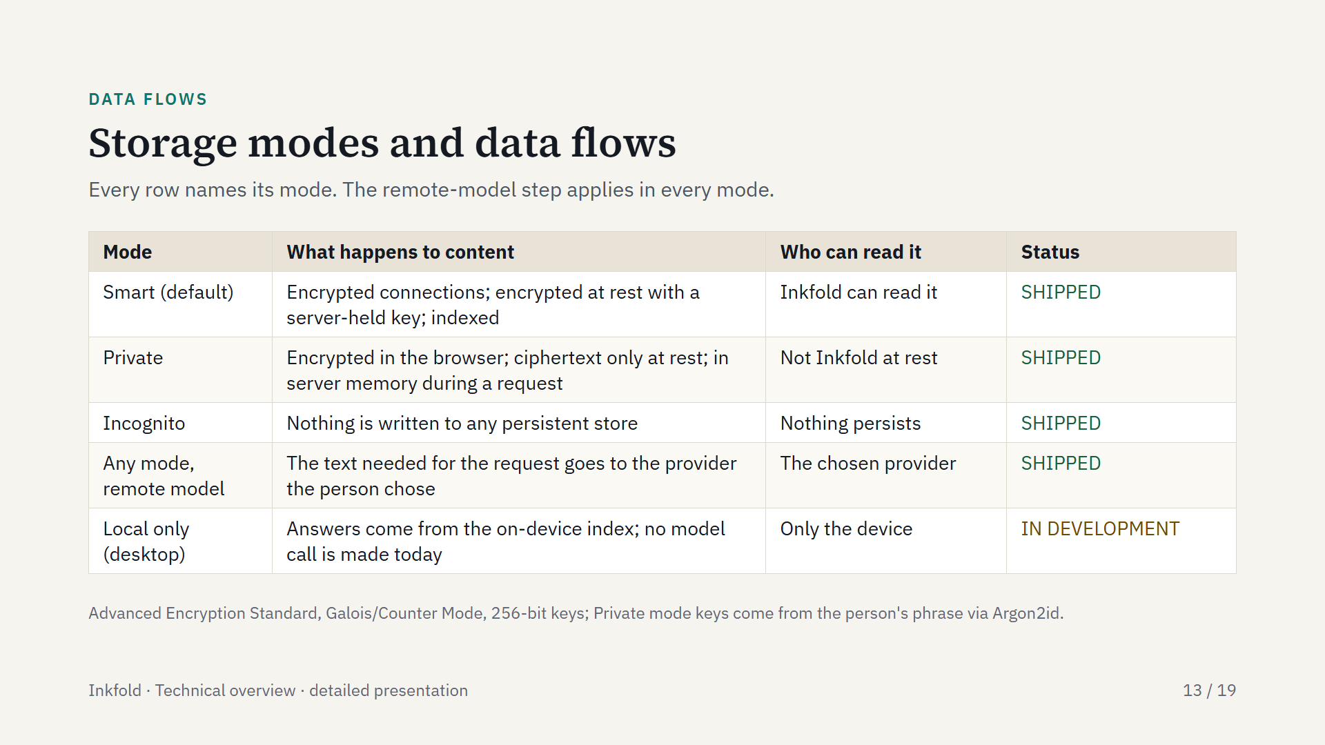
Notes:
Private mode uses the browser's built-in cryptography, with a key derived from the person's phrase by Argon2id and then a hash-based key derivation step using the 256-bit Secure Hash Algorithm. Inkfold cannot restore access to Private mode content if the phrase is lost. Smart mode encrypts at rest with a key the service holds. The desktop identity uses libsodium. No independent assessment of the whole product has been performed.

Slide 14
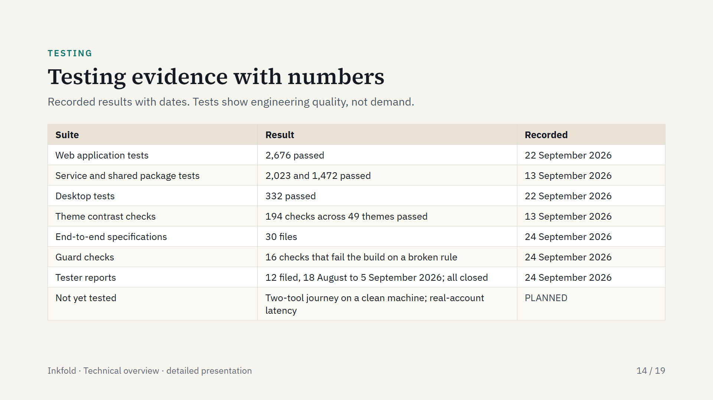
Notes:
The web application count rose from 2,515 passed on 13 September 2026 to 2,676 on 22 September 2026. The guard checks enforce design rules, for example that Inkfold never reads the engine's data directly. Accessibility checks run inside the web tests, and a mobile screen-size check runs on each proposed change.

Slide 15
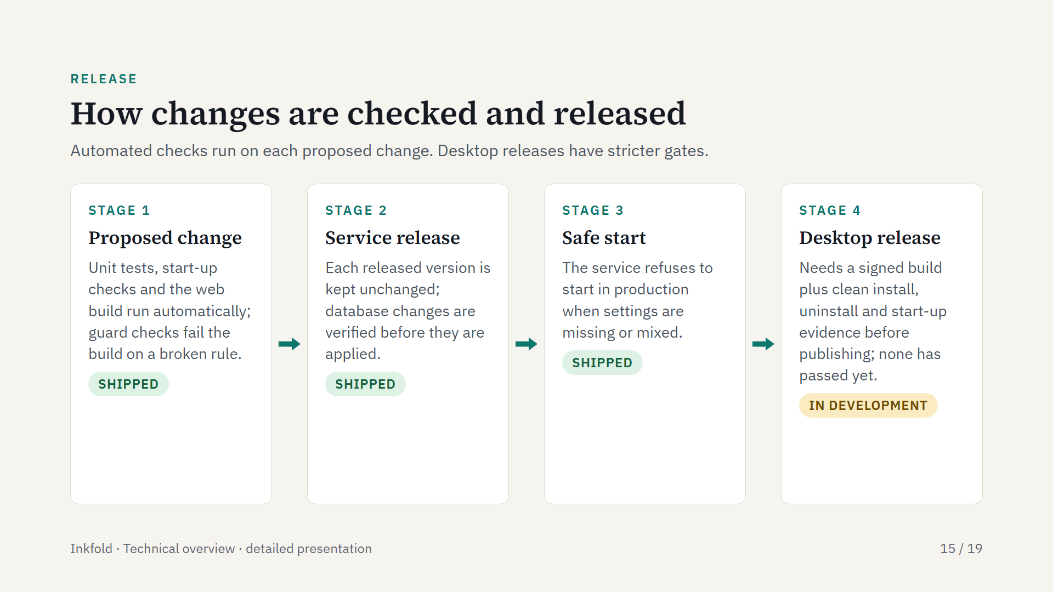
Notes:
Service versions are never edited after release, and database changes pass a verify-first step before an explicit apply. The desktop release process requires a signature and clean-machine evidence; no desktop release has passed it yet.

Slide 16
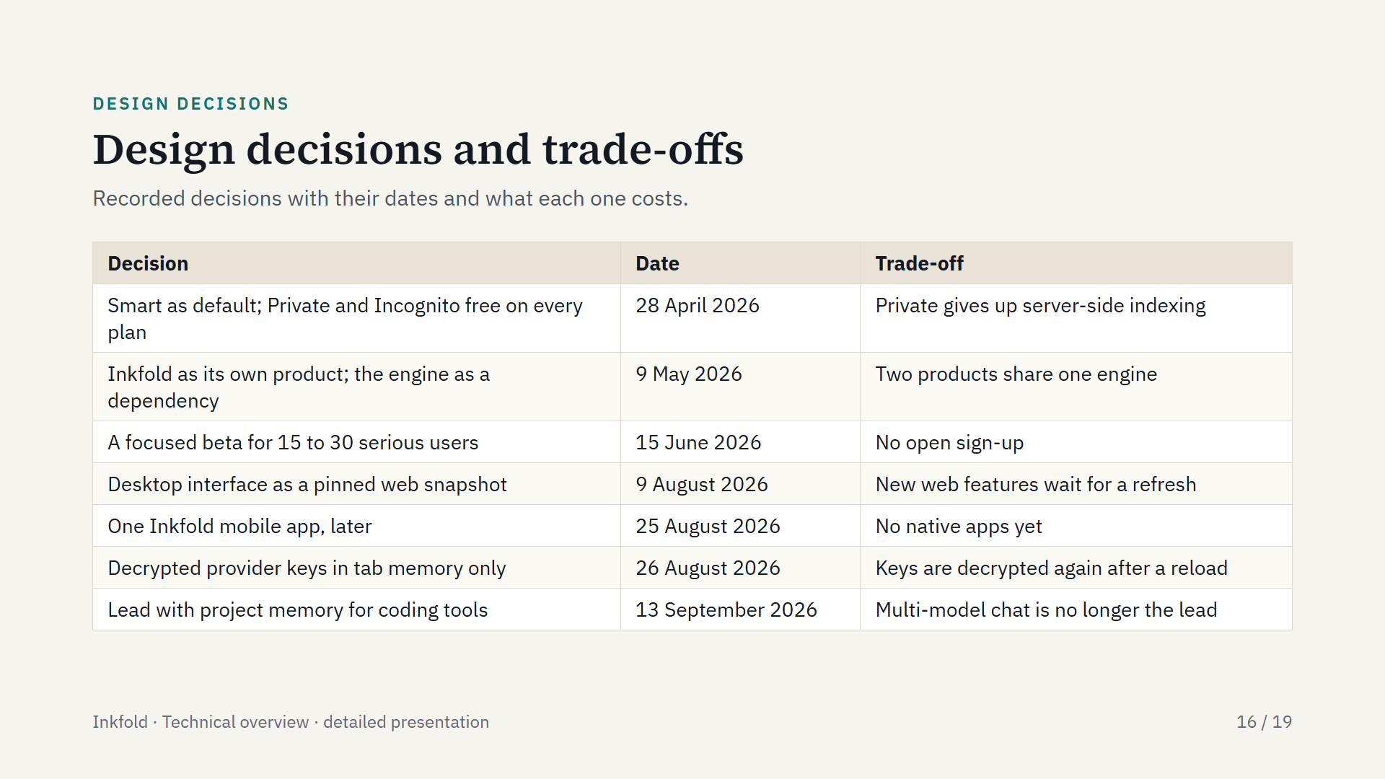
Notes:
Smart became the default while the product had no users, because full-fidelity content lets memory improve as models improve; Private mode stays free but gives up that indexing. The FusionLayer engine is a separate product for developers, and Inkfold is its first customer. Decrypted provider keys are not kept after the tab closes.

Slide 17
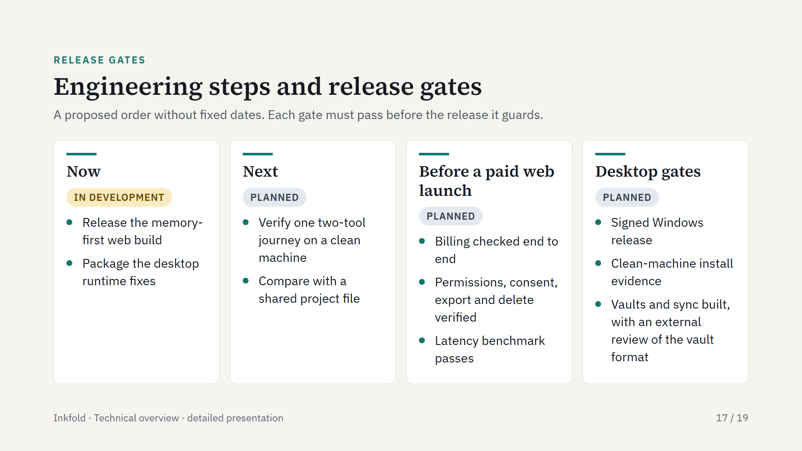
Notes:
The order is a proposal. The paid web launch gates also cover pricing, licence, privacy and support terms. The desktop gates also include a five-journey end-to-end test suite.

Slide 18
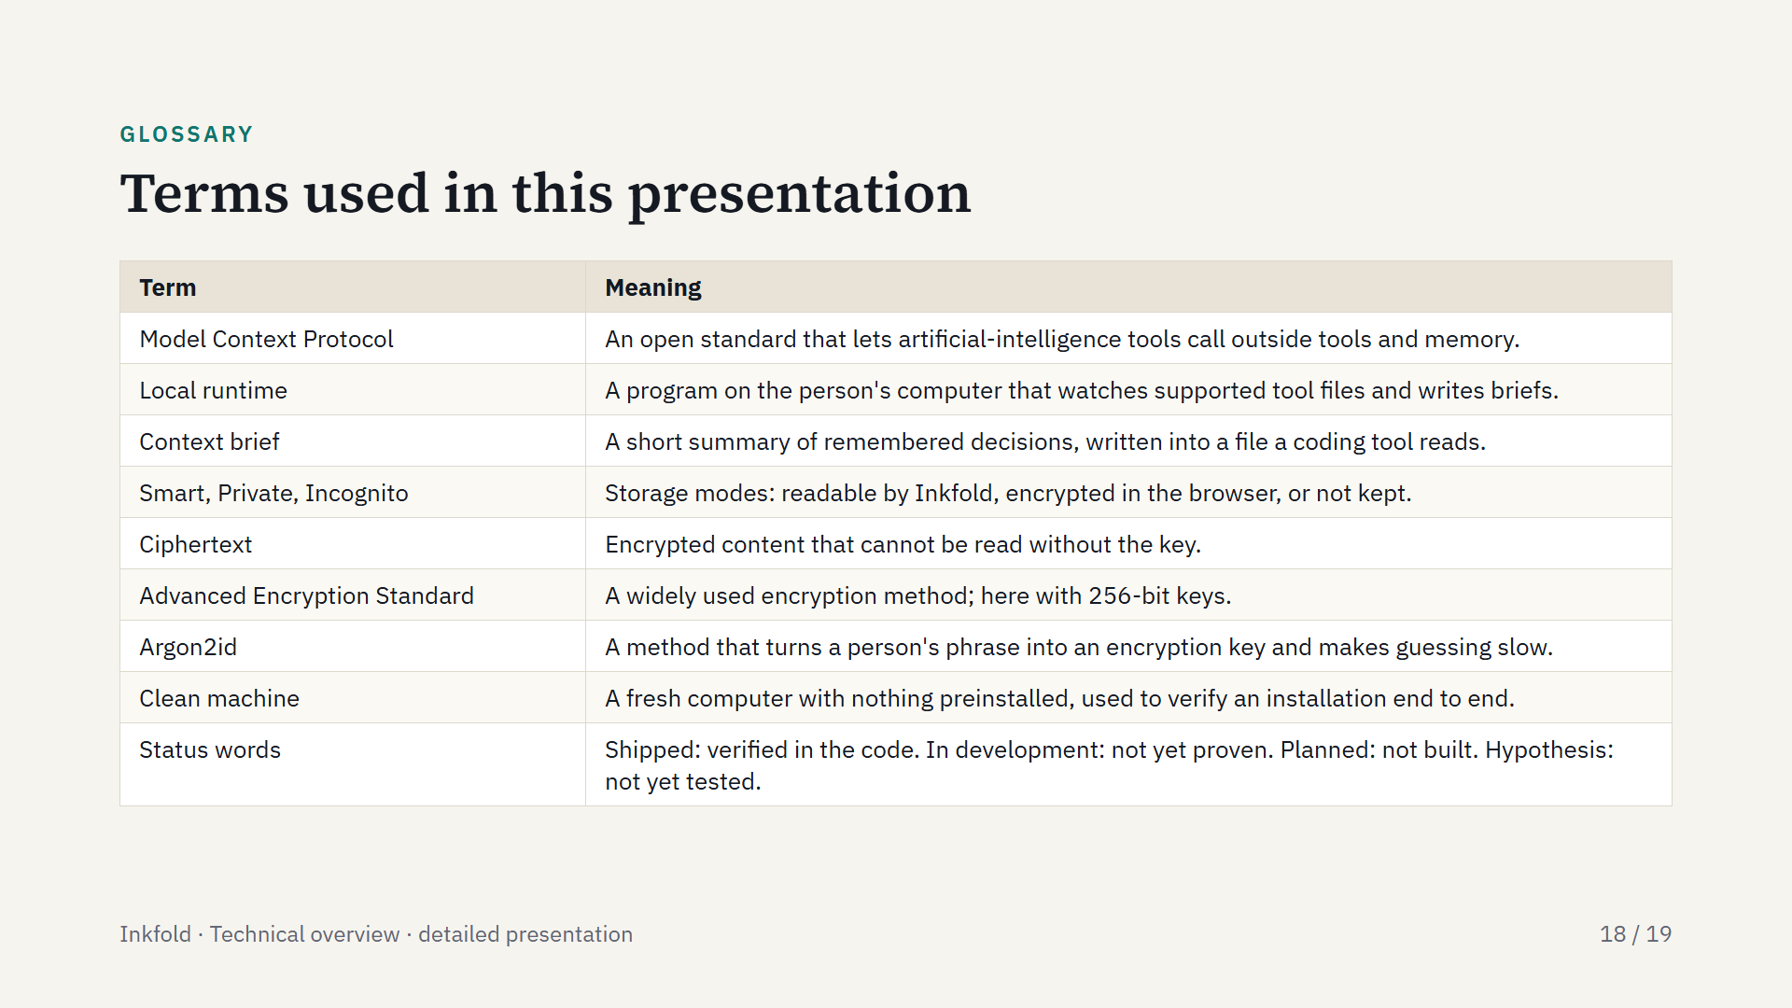
Notes:
Definitions for terms a reader may not know. The four status words are used on every capability in this presentation.

Slide 19
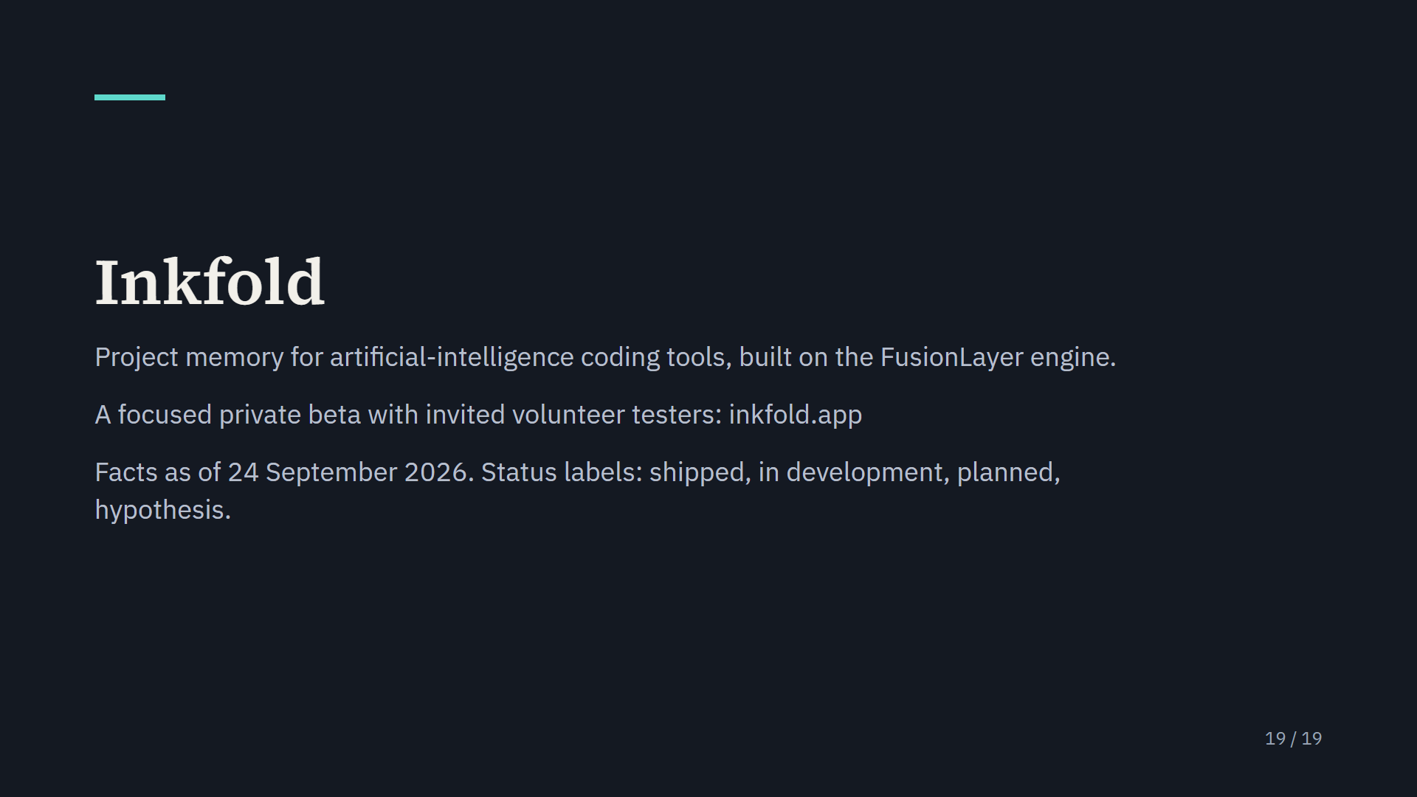
Notes:
Inkfold is in a focused private beta and nothing is charged yet. More at inkfold.app.

