Slide 1
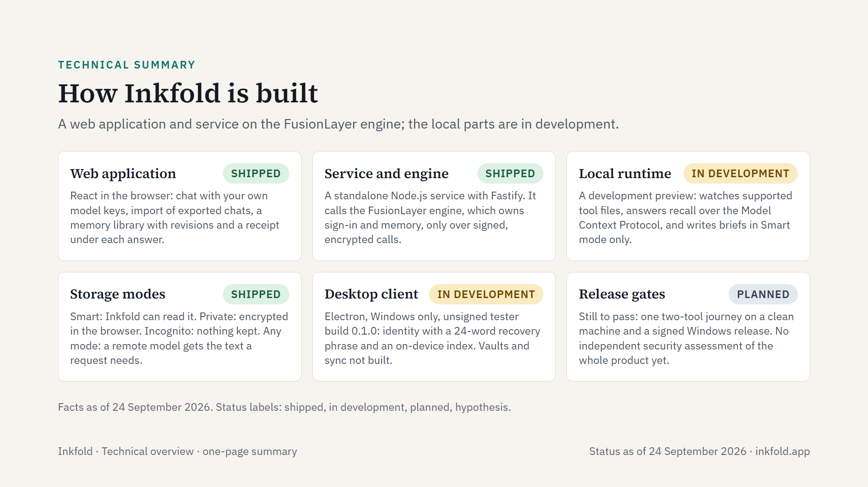
Notes:
Inkfold's technical design on one page, as of 24 September 2026. The web application and Inkfold's own service serve invited testers today; memory, sign-in and model calls run on the FusionLayer engine, a separate product. The local runtime and the Windows desktop client carry context to coding tools and are in development; no tool combination has been verified on a clean machine yet.

